Slide 1
Optical Time Domain Multiplexing (OTDM)
Module 5

Slide 2
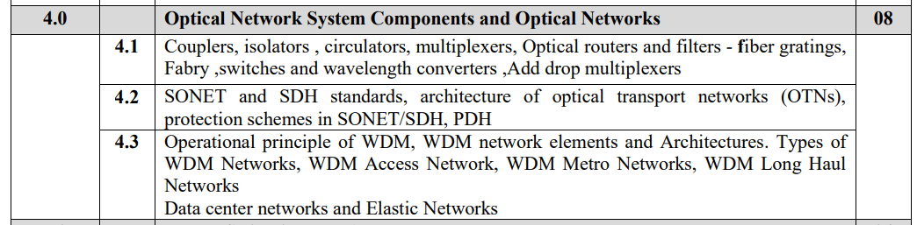
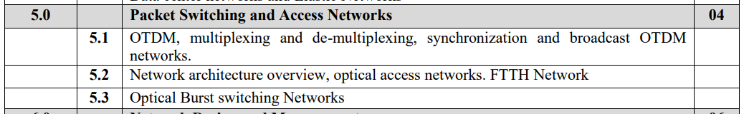

Slide 3
Optical Time Domain Multiplexing
Multiplexer is communication devices that can combine several channel into single channel and Demultiplexing is reconstruct lower data rate signal form multiplexed signal.
There are two type of multiplexing
Electrical multiplexing and Optical Multiplexing.
Basic difference between Electrical multiplexing and Optical multiplexing is shown in Figure 1 and figure 2.
But there exist electronics bottle neck due to bandwidth mismatch that occurs at Electrical to optical conversion, Multiplexer, demultiplxer and Optical to electrical conversion.
Due to this problem maximum bit rate for electrically multiplex system is 10 Gbps

Slide 4
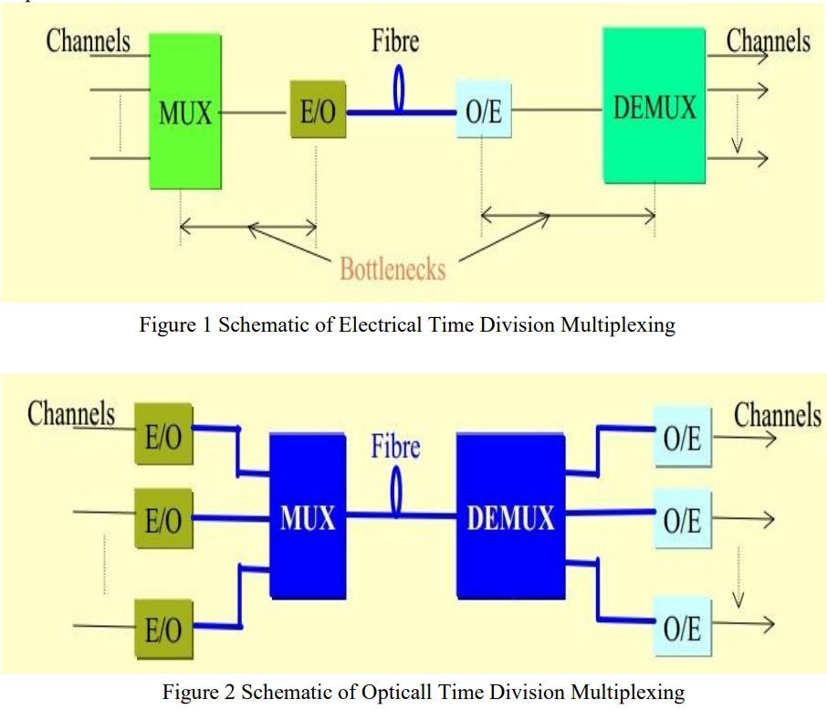

Slide 5
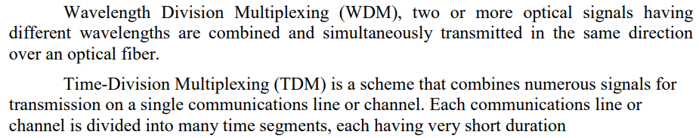

Slide 6
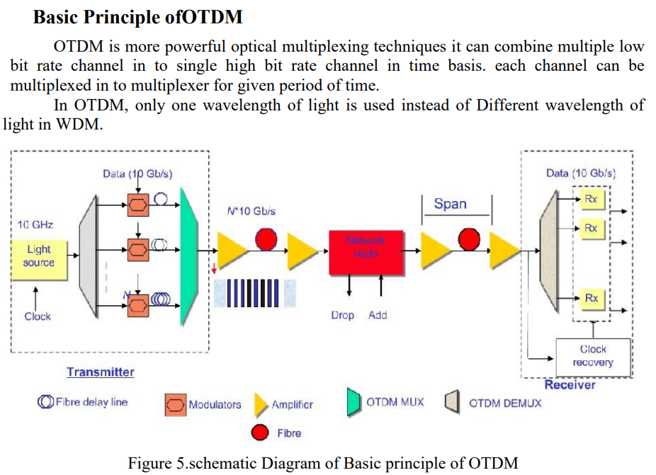
splitter

Slide 7
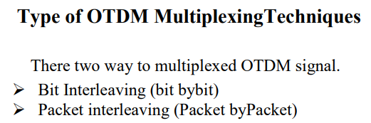

Slide 9
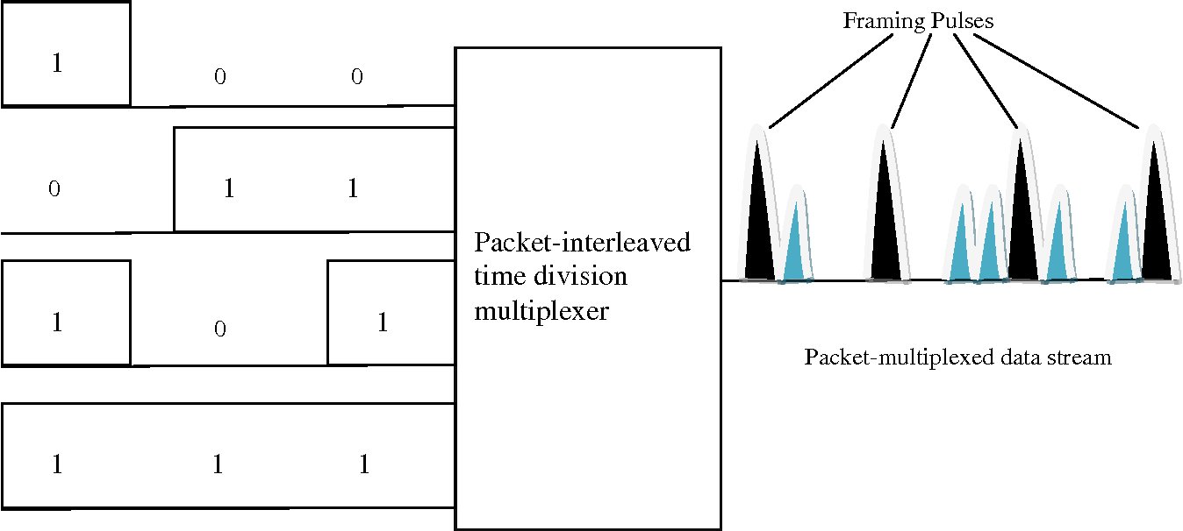

Slide 10
In both the bit-interleaved and the packet-interleaved case, framing pulses can be used.
In the packet-interleaved case, framing pulses mark the boundary between packets.
In the bit-interleaved case, if n input data streams are to be multiplexed, a framing pulse is used every n bits
If n data streams are to be multiplexed and the bit period of each of these streams is T.
If framing pulses are used, then the inter pulse width is τ = T/(n + 1) because n + 1 pulses (including the framing pulse) must be transmitted in each bit period

Slide 11
Velocity of light in silica optical fiber = 2*10^8 m/s
For 1 m fiber,
Time = Distance/velocity = 1/ 2*10^8 m/s = 5 ns
Therefore, delay = 5 ns is introduced in 1m fiber

Slide 12
Operation of Bit interleaving Multiplexing

Slide 14
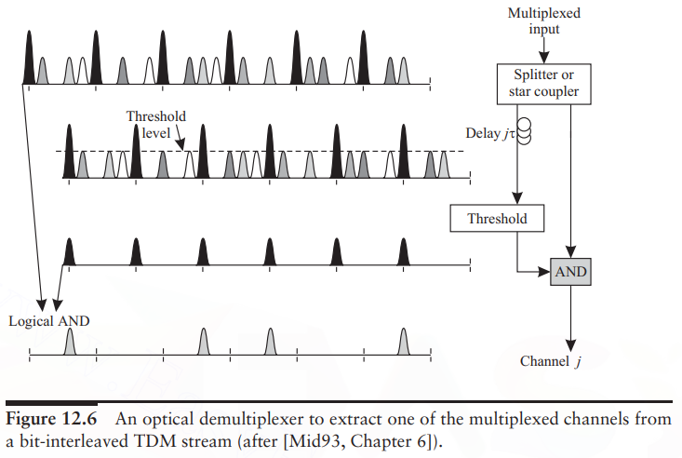
jth

Slide 15
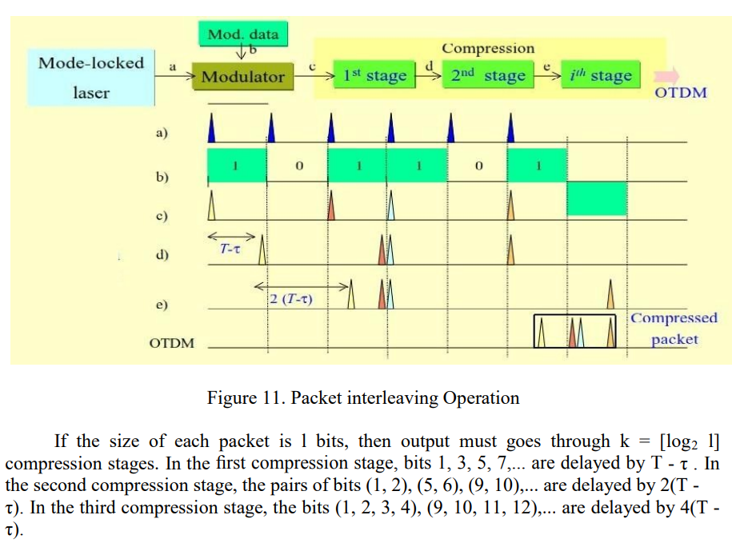
Packet Interleaving
Pack 2 bits = 1 compression stages
Pack 4 bits = 2 compression stages
Pack 8 bits = 3 compression stages
1 2 3 4 5 6 7 8

Slide 16
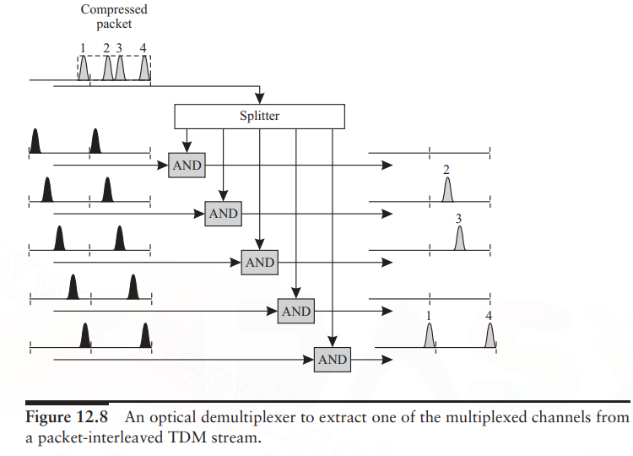
Packet-Interleaved Optical Time Division Demultiplexer:

